Slide 1
MODULE-3
BCSE306
Artificial Intelligence
Dr.Priyanka N
Assistant Professor Senior Grade-1
School of Computer Science and Engineering (SCOPE),
VIT Vellore,
Priyanka.n@vit.ac.in

Slide 2
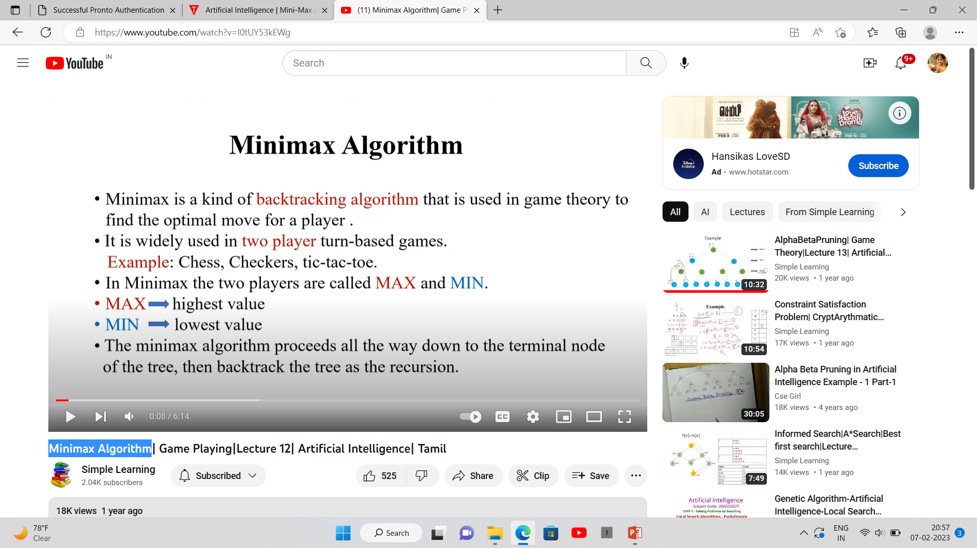
Minimax Algorithm

Slide 3
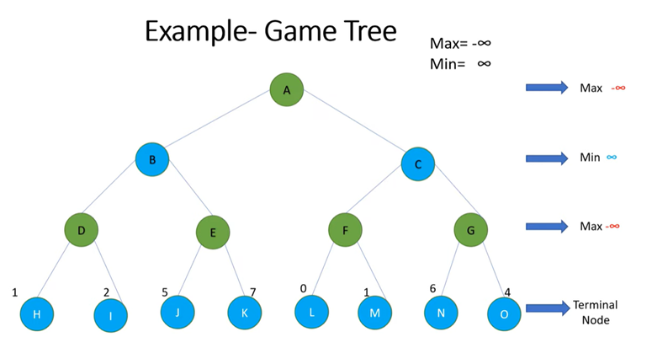

Slide 4
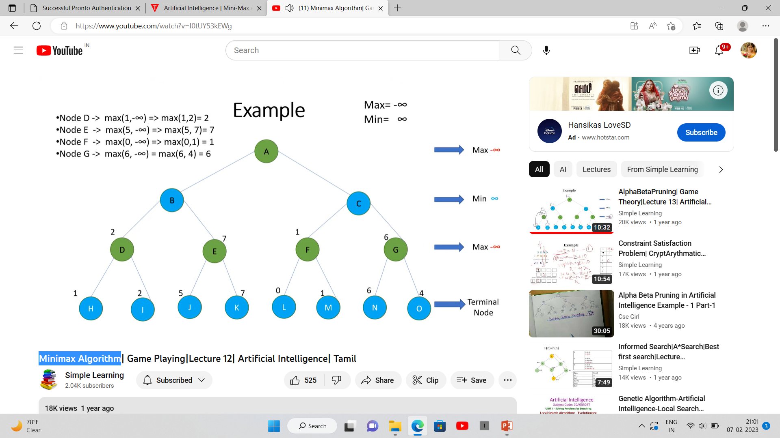

Slide 5
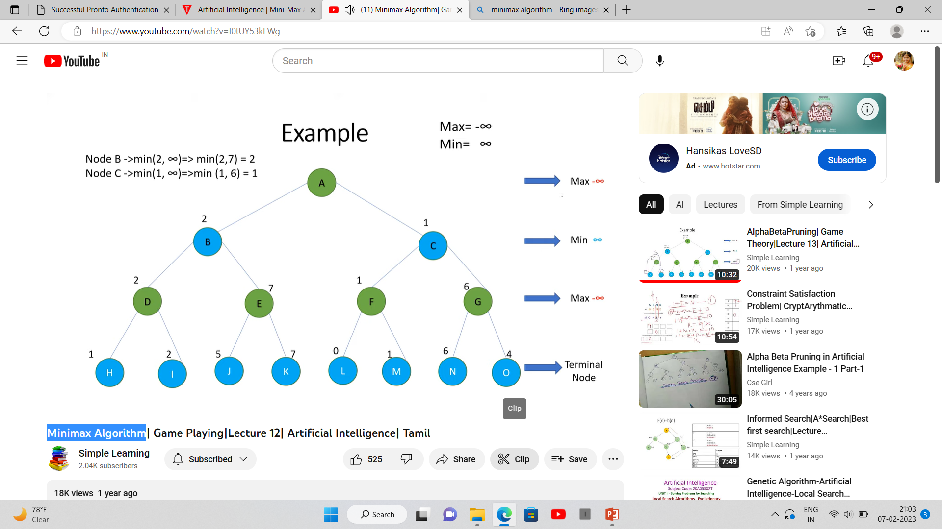

Slide 6


Slide 7
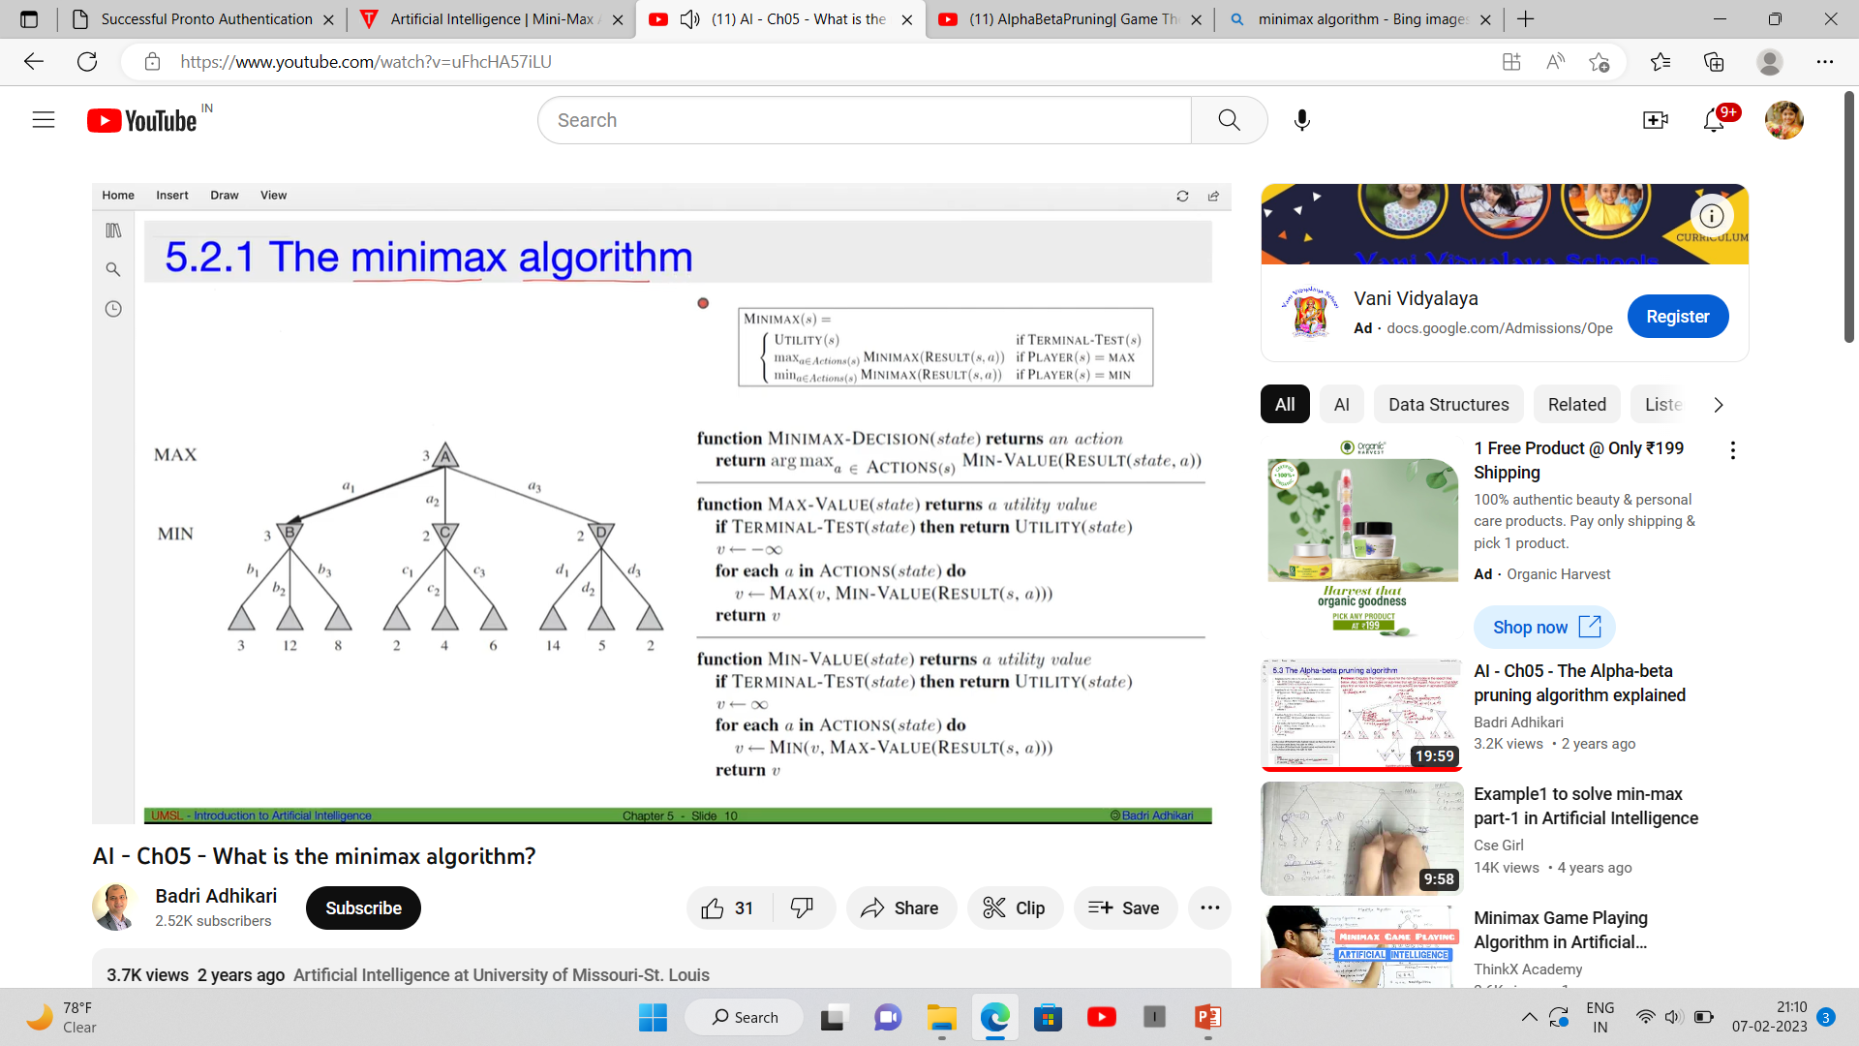
Algorithm

Slide 8
Properties of Mini-Max algorithm
Complete- The Min-Max algorithm is Complete. It will find a solution (if it exists), in the finite search tree.
Optimal- The Min-Max algorithm is optimal if both opponents are playing optimally.
Time complexity- As it performs DFS for the game tree, the time complexity of the Min-Max algorithm is O(b^m), where b is the branching factor of the game tree, and m is the maximum depth of the tree.
Space Complexity- The space complexity of the Mini-max algorithm is also similar to DFS which is O(b^m).

Slide 9
Limitation of the minimax Algorithm
The main drawback of the minimax algorithm is that it gets really slow for complex games such as Chess, go, etc.
This type of game has a huge branching factor, and the player has lots of choices to decide.
This limitation of the minimax algorithm can be improved by alpha-beta pruning.

